Slide 1
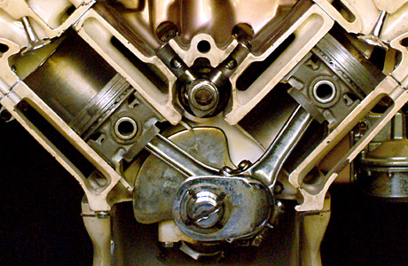
Internal Combustion Engine
I.C Engines

Slide 2
Introduction
Engine: It is a device which converts the available input energy into the desired work output.
Heat Engine: A heat engine is a machine which converts the chemical energy of the fuel into heat energy, and ultimately converts this heat energy into mechanical work.
Heat engines are classified as 1) External Combustion engines (EC engines); and 2) Internal Combustion engines (IC engines).
Heat energy
Mechanical work

Slide 3
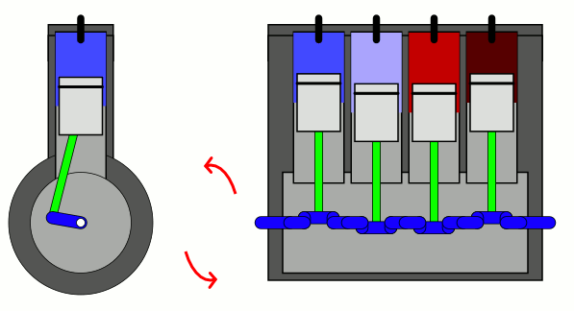
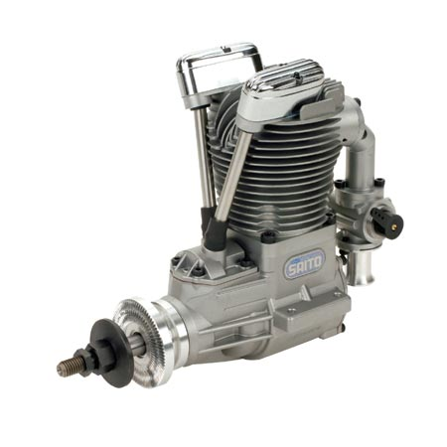
A slider-crank mechanism working animation, and the working principle of a 4-cylinder engine. A slider-crank mechanism is a set-up of four unique rigid link, interconnected in such a way that it can convert a reciprocating motion into a rotary motion (or vice-versa)

Slide 4
Classification
According to type of fuel used.
Petrol engine.
Diesel engine.
Gas engine.
According to number of strokes per cycle.
4 – stroke engines.
2 – stroke engines.

Slide 5
Classification
According to method of ignition.
Spark ignition.
Compression ignition.
According to the cycle of combustion.
Otto cycle.
Diesel cycle.
Duel combustion.
According to the number of cylinders.
Single cylinder.
Multi cylinder.

Slide 6
Classification
According to the arrangement of cylinders
Vertical engine.
Horizontal.
Inline engine.
Radial engine.
V- engine.
According to method of cooling
Air cooled engine.
Water cooled engine.

Slide 7
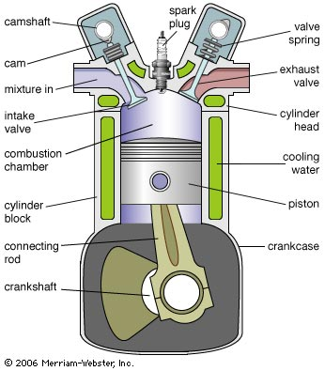

Slide 8
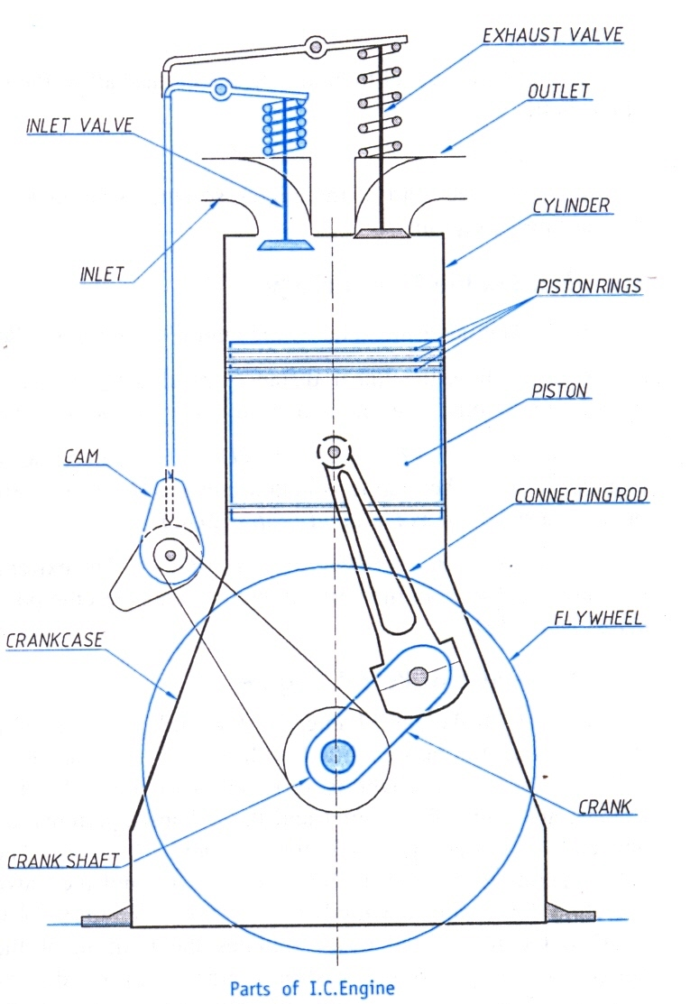
Parts of I.C Engine
Cylinder
Piston
Piston rings
Connecting rod
Crank and crankshaft
Valves
Flywheel
Crankcase
Cam and its actuating mechanism
Spark plug / fuel injector

Slide 9
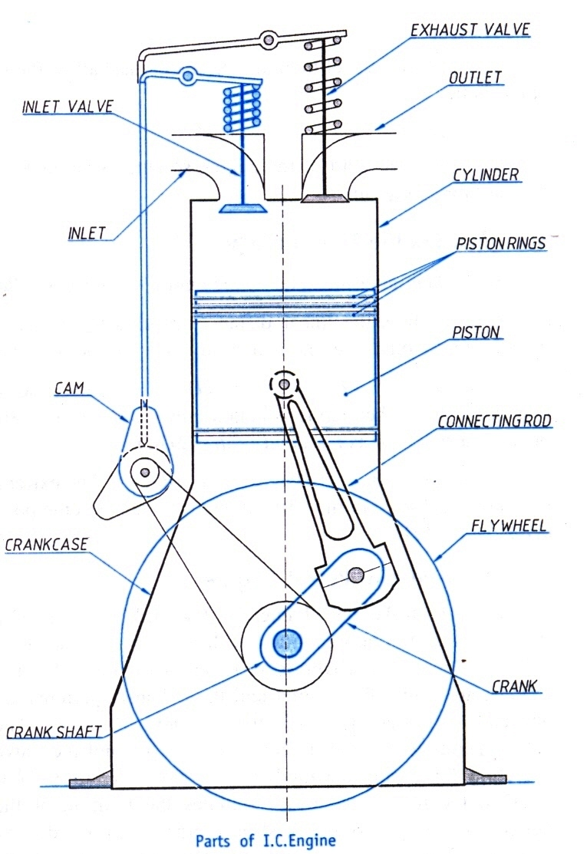
Cylinder
Part of the engine where fuel is burnt and power is developed.
Inside diameter is called as bore.
Sleeve is fitted tightly in the cylinder to prevent wearing of block.

Slide 10
2. Piston
Close fitting hollow – cylinder plunger moving to and fro in the cylinder.
Function – power developed by the combustion of fuel is transmitted by piston to the crank-shaft through the connecting rod.

Slide 11
3. Piston rings
Metallic rings inserted into groves provided at top end of the piston.
Function – it maintains a gas-tight joint between the piston and the cylinder, and for wiping the inner walls of cylinder in each stroke.

Slide 12
4. Connecting rod
Link that connects the piston and crankshaft by means of pin joint.
Function – it converts the rectilinear motion of the piston (means, to and fro motion) into rotary motion of crank and crankshaft.

Slide 13
5. Crank and crankshaft
Crank is a rotatory lever that connects crankshaft and piston rod (connecting rod). It is the first rotating element in the engine. Crank causes rotation of the crank-shaft.
6. Valves
These are components which control the flow of intake and exhaust gases. Valves are controlled by valve-rods and springs assembly, which, in turn, controlled by a push-rod and a toggle link.

Slide 14
7. Fly wheel
A heavy wheel Mounted on crankshaft on one side, to maintain uniform rotation of crankshaft i.e. to avoid speed fluctuations. It acts like an energy reservoir and stores surplus energy; and delivers energy when required.
8. Crankcase
Enclosure for crankshaft and sump for lubricating oil.

Slide 15
9. Cam and its actuation mehcanism : It is a rigid metallic member which converts rotatory motion into rectilinear motion (to-and-fro motion). It helps in opening /closing of the inlet/outlet valves of the engine. A valve actuating rod and toggle link is also used with it.

Slide 16
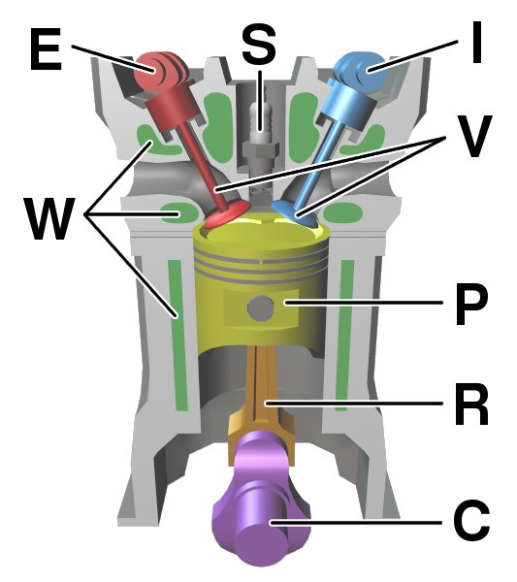
Spark plug / Fuel injector
These are used for ignition or entrance of the fuel inside the combustion chamber.
A spark plug is used in SI engines (Petrol engines) for creating a spark for ignition.
A fuel injector is used in CI engines (Diesel engines) for entrance of diesel inside combustion chamber).
Both of these devices operate at the end of compression stroke (2nd stroke) and just before the power stroke (3rd stroke).

Slide 17
Terms used in the previous slide image…
E – Exhaust valve
S/FI – Spark plug or Fuel Injector
I – Intake valve
W – Water jackets (for cooling)
V- Valves
P – Piston
R- Connecting Rod
C- Crankshaft

Slide 18
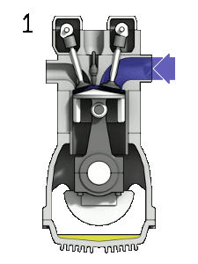

Slide 19
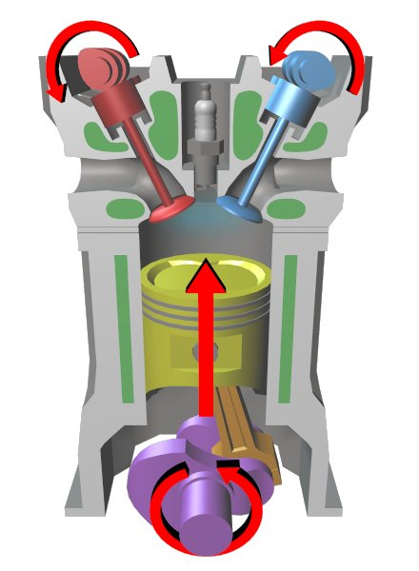
Four stroke petrol engine
Four stroke petrol engine consists of
Cylinder
Cover
Mechanically operated valves
Spark plug
Connecting rod and crank

Slide 20
Four stroke petrol engine
Suction stroke
Compression stroke
Power stroke (Expansion stroke)
Exhaust stroke

Slide 21
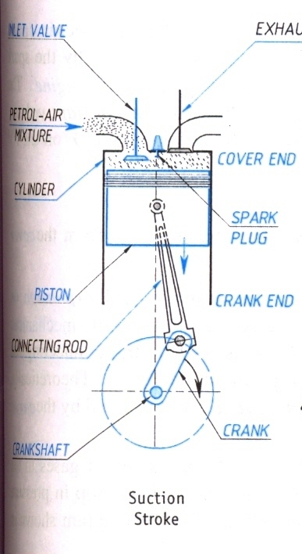
Suction stroke
Inlet is open exhaust is closed.
Piston moves from TDC to BDC.
Crankshaft revolves half the rotation.
Cranking
Petrol air mixture drawn into cylinder due to pressure difference.

Slide 22
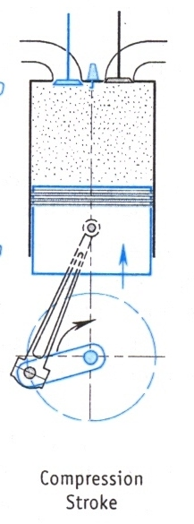
Compression stroke
Both inlet and exhaust are closed.
Piston moves from BDC to TDC.
Crankshaft revolves half the rotation.
Cranking
Petrol air mixture is compressed to a ratio of 1:11.
This mixture is ignited by spark plug.

Slide 23
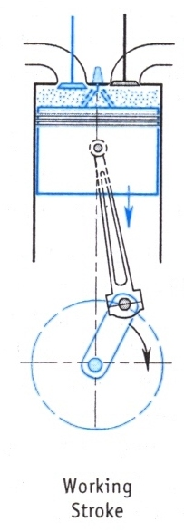
Power stroke
Piston moves from TDC to BDC due to expansion of burnt gases.
Crankshaft revolves half the rotation.
burnt gases generate energy and force the piston to move down.

Slide 24
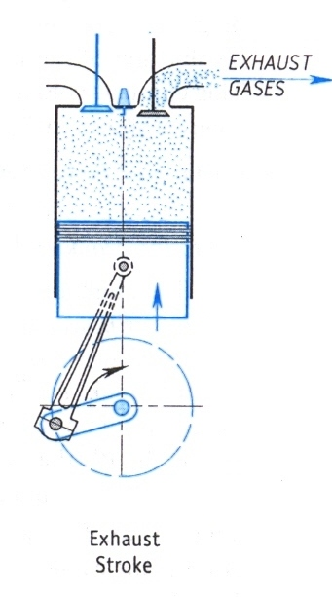
Exhaust stroke
exhaust is open and inlet is closed.
Piston moves from BDC to TDC.
crankshaft revolves half the rotation.
energy for this stroke is supplied by flywheel.
Burnt gases are expelled out through outlet port.

Slide 25
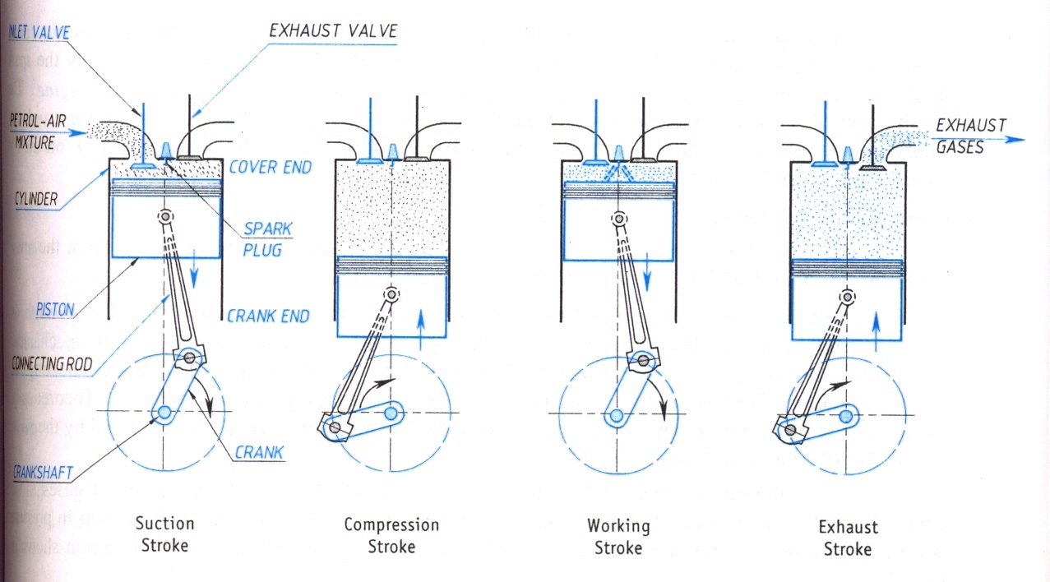
Four stroke petrol engine

Slide 26
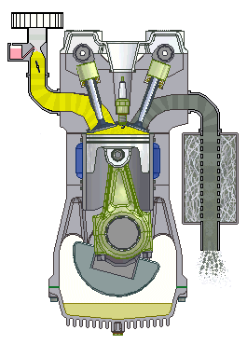
4 stroke petrol engine (SI engine) working animation

Slide 27
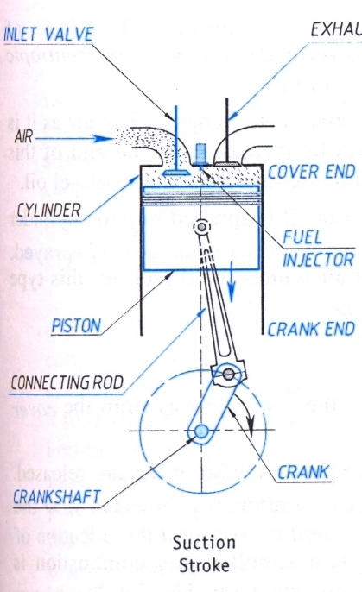
4 Stroke Diesel Engine
Suction stroke
Inlet is open exhaust is closed.
Piston moves from TDC to BDC and crankshaft revolves half the revolution.
Cranking during first cycle.
Due to the pressure difference air enters the cylinder through air filter.

Slide 28
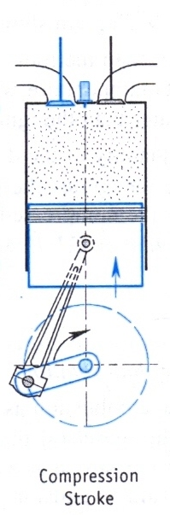
Compression stroke
Inlet and exhaust are closed.
Piston moves from BDC to TDC.
Cranking required in first cycle.
Air will be compressed to a ratio of 1:20.
Diesel oil is sprayed into cylinder by injector and auto-ignition takes place.

Slide 29
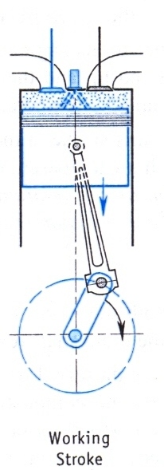
Power stroke
Piston moves from TDC to BDC.
Inlet and exhaust valves are closed.
burnt gases generate energy and force the piston to move down till injection of fuel is complete.

Slide 30
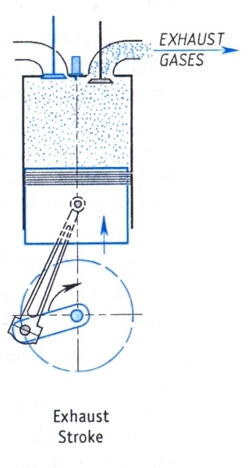
Exhaust stroke
exhaust is open and inlet is closed.
Piston moves from BDC to TDC.
crankshaft revolves half the rotation.
energy for this stroke is supplied by flywheel.
Burnt gases are expelled out through outlet port.

Slide 31
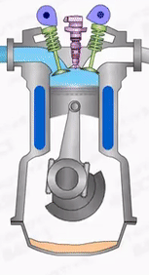
4 stroke diesel engine (CI engine) working animation

Slide 32
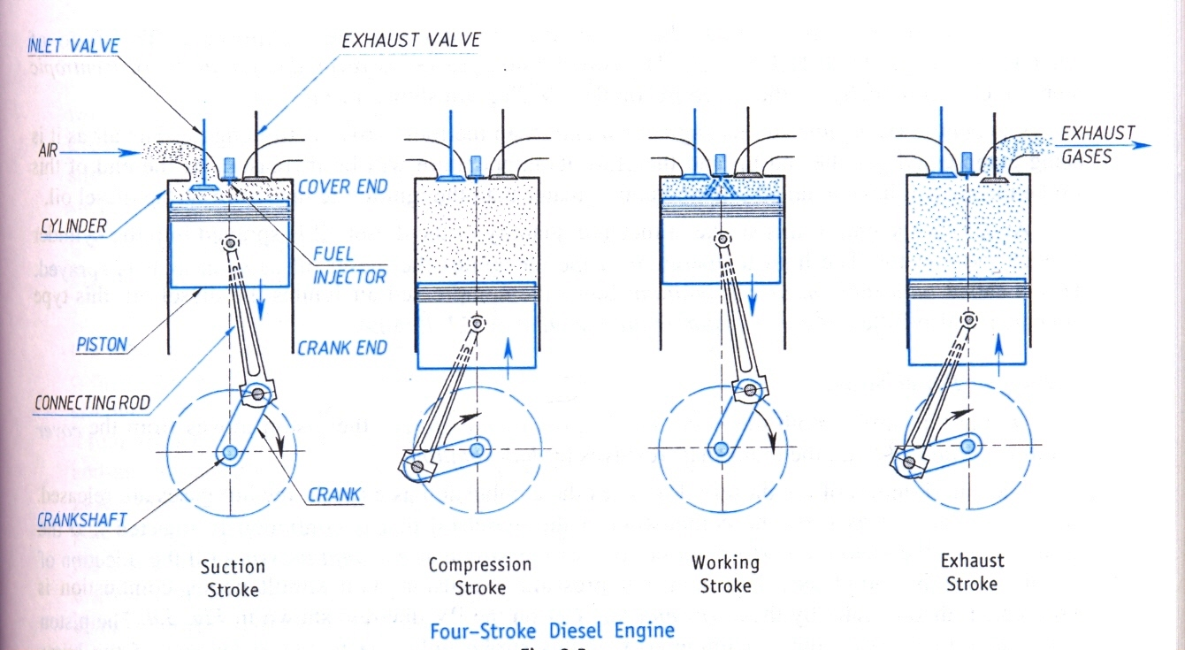

Slide 33
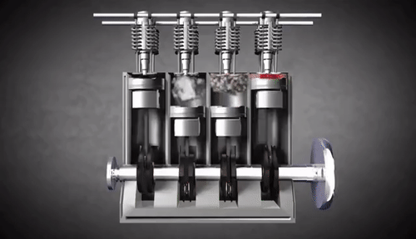
4 Cylinder 4-stroke IC Engine working animation

Slide 34
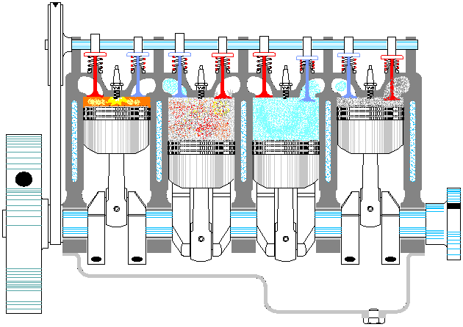

Slide 35
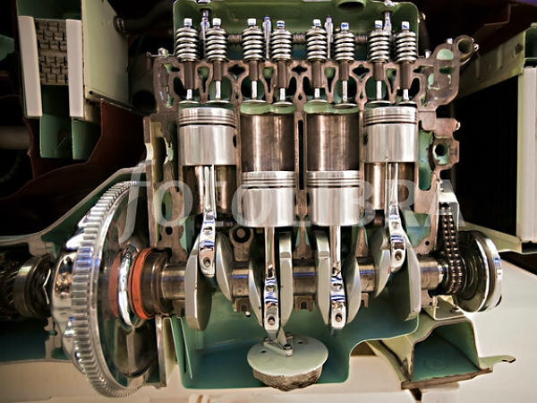

Slide 36
Some definitions related to IC Engines
Bore : The internal diameter of the combustion chamber is known as bore.
TDC : Top Dead Centre. The top most position of the piston in a vertically aligned engine. The volume of the combustion chamber is minimum in this position, and piston is farthest from the crank case.
BDC : Bottom Dead Centre. The bottom most position of the piston in a vertically aligned engine. The volume of the combustion chamber is maximum in this position, and piston is closer to the crank case.

Slide 37
Some definitions related to IC Engines
IDC : Inner Dead Centre. The inner most position of the piston in a horizontally aligned engine. The volume of the combustion chamber is minimum in this position.
ODC : Outer Dead Centre. The outer most position of the piston in a horizontally aligned engine. The volume of the combustion chamber is maximum in this position.
Stroke : The movement of the piston from TDC to BDC, IDC to ODC or vice versa is called as a stroke. i.e., it is the movement of the piston between its two extreme positions. In one stroke, the crank rotates by an angle of 180 degrees, i.e. half rotation.

Slide 38
Some definitions related to IC Engines
Clearance Volume : It is the minimum possible volume of the fuel+Air mixture (or only air) at the end of compression stroke.
Compression Ratio : It is the ratio of maximum volume inside the combustion chamber to the clearance volume. It shows to what extent the air or fuel+air mixture is compressed by the moving piston inside the combustion chamber. It varies between 8 to 12 for SI engines (petrol engines) and 16-22 for CI engines (diesel engines)

Slide 39
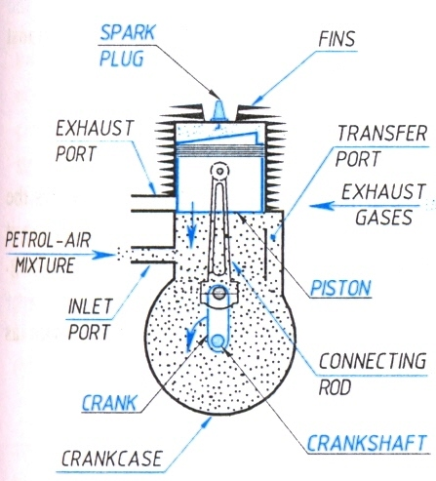
Two stroke petrol engine
Performs two strokes to complete one working cycle.
Works on theoretical Otto cycle.

Slide 40
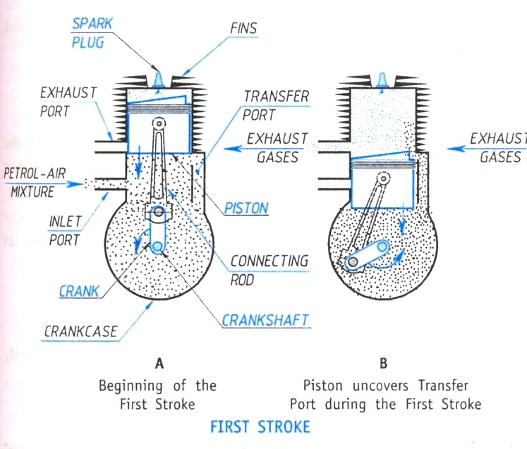
Two stroke petrol engine

Slide 41
Parts
Cylinder with one end fitted with cover and other end with a sealed crankcase.
Ports are provided one below other on circumference of the cylinder.
Lower one is the admission port or inlet port and upper port is the exhaust port.
Transfer port diametrically opposite.

Slide 42
Transfer port
Function – transfer of petrol air mixture from crankcase to cylinder.
Spark plug, connecting rod, crank.

Slide 43
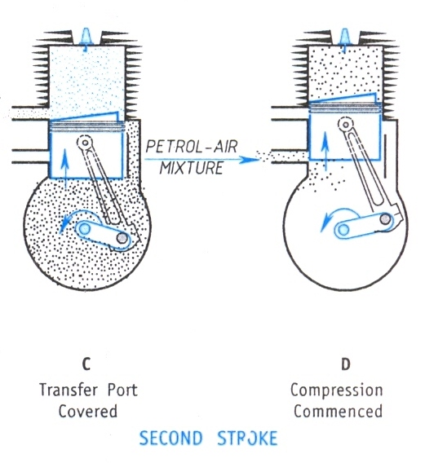
First stroke or upward stroke
Piston moves from BDC to TDC.
Air fuel mixture is drawn in through inlet.
Supply of petrol air mixture is cut off in upward motion of piston.
Further piston will compress the petrol air mixture in cylinder.

Slide 44
At the end of the stroke spark plug ignites and combustion takes place.

Slide 45
second stroke or downward stroke
Piston moves from TDC to BDC.
Piston performs the power stroke.
Transfer port opens letting the fresh charge into cylinder.

Slide 46
Due to this the burnt gases are expelled out of the cylinder. This process is called as scavenging.
Crankshaft rotates by half the revolution.

Slide 47
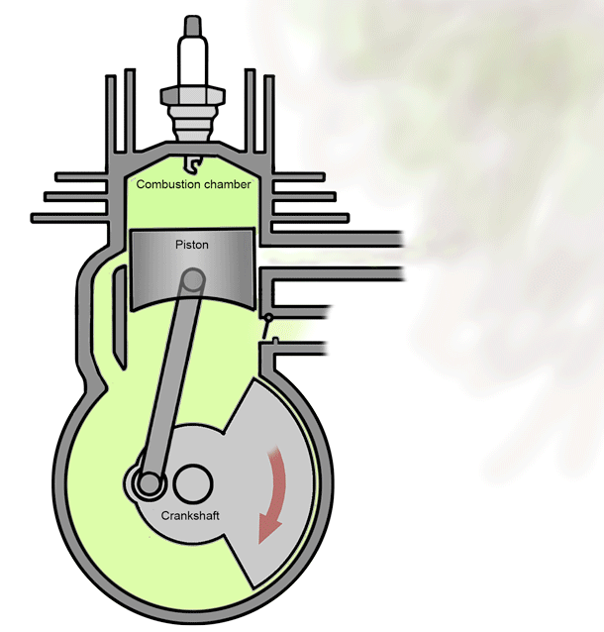

Slide 48
Scavenging Process
In case of 2-stroke engines, there is no dedicated exhaust stroke. Scavenging is observed in its place.
It is the process in which the burnt gases inside the combustion chamber are pushed out by the fresh charge (fuel + Air) entering from the transfer port. This replacement of burnt gases by the fresh charge is called scavenging. A crown shaped piston (a piston with a deflector above it) helps in execution of scavenging.

Slide 49
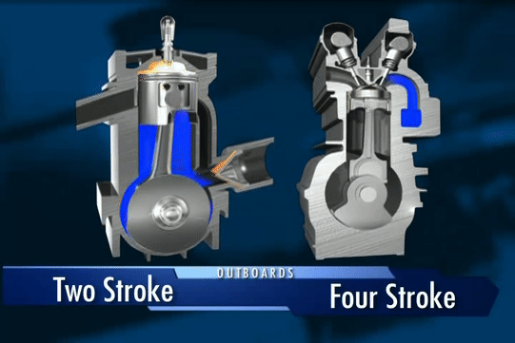

Slide 50
Criteria | S.I engine | C.I engine
Combustion process | Ignition takes place by a spark generated by spark plug. | Self ignition of the fuel take place due to high compression of air in chamber.
Compression ratio | 1 : 11 | 1 : 22
Suction | Mixture of petrol and air in calculated ratio is drawn into cylinder. | Only pure air is drawn into cylinder during suction stroke.
Fuel | Petrol | Diesel
Thermodynamic cycle | Otto cycle | Diesel cycle
Weight of the engine | Less because of lower compression ratio, cylinder size is small. | High, engine size is large due to higher compression ratio.
Efficiency | Low because of lower compression ratio. | High because of high compression ratio.
Speed | High because of lighter engine. | Lower because of heavy engine.

Slide 51
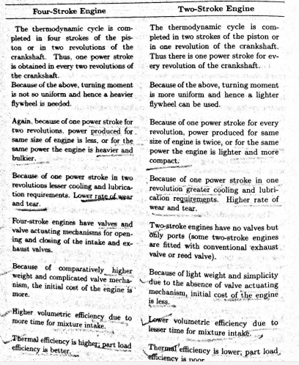

Slide 52
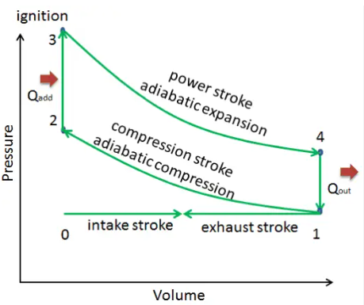
Otto Cycle PV diagram for SI engines

Slide 53
Otto Cycle PV diagram for SI engines
0-1 : Intake of fresh charge at constant pressure (1st stroke). Piston moves from TDC to BDC.
1-2 : rev. adiabatic compression (2nd stroke). Piston moves from BDC to TDC.
2-3 : Combustion of fuel+air due to spark. Constant volume heat addition, and rise in pressure.
3-4 : rev. adiabatic expansion (3rd stroke). Piston moves from TDC to BDC.
4-1 : Opening of exhaust valve and sudden pressure drop to atmospheric P (constant volume heat rejection).
1-0 : Exhaust stroke (4th stroke) at constant pressure. Piston moves from BDC to TDC.

Slide 54
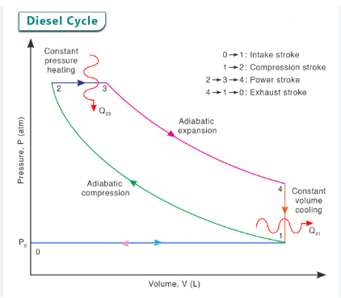
Diesel Cycle PV diagram for CI engines

Slide 55
Diesel Cycle PV diagram for CI engines
0-1 : Intake of only air at constant pressure (1st stroke). Piston moves from TDC to BDC.
1-2 : rev. adiabatic compression (2nd stroke) of air. Piston moves from BDC to TDC.
2-3 : Admission of diesel in from of spray through fuel injector and its combustion. Constant pressure heating with increasing volume (3rd stroke already started from point 2).
3-4 : rev. adiabatic expansion (3rd stroke continued). Piston moves from TDC to BDC.
4-1 : Opening of exhaust valve and sudden pressure drop to atmospheric P (constant volume heat rejection or ‘cooling’).
1-0 : Exhaust stroke (4th stroke) at constant pressure. Piston moves from BDC to TDC.

